Slide 1
Cyber security
Alexander Holguin
Michelle Hernandez
Dallas Grantham
Lauren Griffith
Cody Jones
Jason Kim
Quy Huynh

Slide 2
Spyware Intrusion
By Alexander Holguin

Slide 3

Spyware
Collecting information without users knowledge
Advertising
Potential of changing the configuration of your computer

Slide 4

Is (all) spyware malware?
NO! Spyware is generally viewed as malware
Businesses
Public computers

Slide 5
Spyware intrusion (how are you infected)
Not spread like a virus or a worm
Spread via infected web pages and downloads
Deception
Can be distributed through genuine software
  Kazza
  WeatherBug
  Morpheus

Slide 6
Legal (ethical) issues
Users never give consent to install spyware on their computers, under U.S. Fraud and Abuse Act, this is illegal
However, spyware developers claim to obtain user consent through EULA agreements, this can arguably be considered legal
Is this ethical?

Slide 7
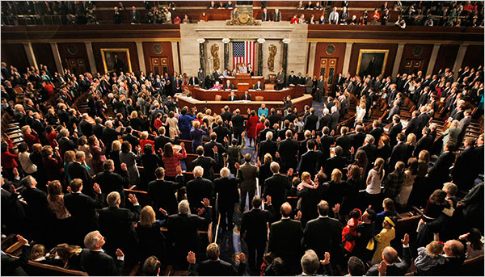
Internet Spyware Prevention Act
I-SPY was introduced in 2004, passed in 2005
Act establishes that any sort of programs that use a form of data collection would be criminalized (this excludes cookies)
Imposes penalties of up to 5 years of prison time and fines

Slide 8
Some (ethical) things to think about
Just because a company owns a computer, does it give them the right to monitor or store personal employee information?
Just because a EULA agreement is accepted, does it give the developer the right to install any type of software (malicious or not) onto the end users computer?

Slide 9
Full Disclosure
By Michelle Hernandez

Slide 10
Definition
“Full disclosure requires that full details of a security vulnerability are disclosed to the public, including details of the vulnerability and how to detect and exploit it.”

Slide 11

History
First issue of full disclosure was involving locksmithing in the 19th century
The issue was whether locksmiths should disclose all the information about the lock they manufacture or not
Primarily oriented to one thing, the loopholes in the locks that locksmith create
Should the customer be disclosed this when buying the locks or should it be kept a secret?

Slide 12

In Early 1990s
Debate on dissatisfaction at method employed by internet security infrastructure
Software security were reported to CERT/CC
CERT/CC would inform the vendor of the software
Public disclosure would not take place until the vendor had prepared a patch to fix it

Slide 13
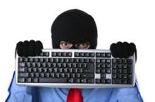
Issues
Since disclosures were private, some vendors took years to produce a fix or never produced a fix at all
Vulnerabilities were actively exploited by hackers

Slide 14
Controversy
Full disclosure include code or executable tools exploit the vulnerabilities
Argument against disclosure is that it provides complete details or tools to malicious attackers (black hats and script kiddies)
But, the argument assumes that without disclosure such tools and attacks would not occur
Advantage of disclosure is that white hats would use the information and that the vulnerability will be detected and patched more quickly.

Slide 15
Case of Full Disclosure
Massachusetts Bay Transportation Authority (MBTA) v. Anderson (2008)
Case was to prevent three Massachusetts Institute of Technology (MIT) students from publicly presenting a security vulnerability they discovers MBTA’s Charlie Card automated fare collection system
Judge granted the students the right to discuss and present their findings.

Slide 16
class discussion question
Is it ethical for a vendor to know that there is a vulnerability in their product and not inform the customer about it?

Slide 17
Security
By Dallas Grantham

Slide 18
Prevent Malware:
Spyware, Scareware, Trojans, Worms, and Viruses
They
Invades your privacy
Steal your information
Bombard you with pop-up windows
Slow down your computer
Crash your computer

Slide 19
Steps You Can Take
Use a firewall
  Most malware and other unwanted software come bundled with other programs or from websites, or even placed remotely by hackers. Firewalls can help catch them before they do harm

Slide 20
Steps You Can Take
Update your software
  Download and install the latest critical and security updates for all your software to patch up any known exploits

Slide 21
Steps You Can Take
Download and Install Protection
  Spybot Search and Destroy
  Malwarebytes Anti-Malware
  Windows Security Essentials

Slide 22
Steps You Can Take
Don’t download it in the first place
  Only download from websites you trust
  Do a search if you’re not sure you can trust a program
  Never click “Agree” or “OK” to close a window, click the red “x” in the corner or hit ALT + F4
  Watch out for free music and movie file-sharing programs
  Stay away from those bad sites

Slide 23
Google Bombing
By Lauren Griffith

Slide 24
What is Google Bombing?
Efforts to link to a site by a key phrase resulting in artificially elevating a website
Key phrases are not actually located on the website itself
Goal is to make the desired website the number one result when the key phrase is searched

Slide 25
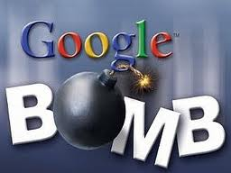
Why?
Politically motivated
Pranks
Self Promotions
Competitions

Slide 26
Well Known Examples
First case of Google Bombing:
  Adam Mathes gave instructions to create the hyperlink , “talentless hack”, to his friends website
Political :
  The phrase “miserable failure” was bombed to make George W Bush’s biography the top result
Comical:
  The phrase “find Chuck Norris” top result is a fake Google results page that say, “Google won’t search Chuck Norris because it knows you don’t find Chuck Norris, he finds you”

Slide 27
What did Google do?
In the beginning, they did nothing
  “…. Pranks like this may be distracting to some, but they don't affect the overall quality of our search service…” –statement from Google
Since then, they have changed their algorithm that has removed most Google Bombs
  Large number of links with the same names created in a short about of time must likely won’t be counted

Slide 28
Integrated Systems
By Cody Jones

Slide 29
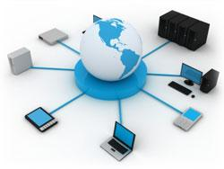
What is system integration?
System integration is the linking together of different systems and/or software.
This can be physically or functionally.
This is to coordinate everything at one spot.

Slide 30
Why Integrate Systems?
Runs faster then separated.
Can add new functionality from subsystems interacting.
Cuts out the middleman.

Slide 31
Problem?
Nontechnical attacks:
Manipulating people.
Physical Theft
Network infrastructure attacks:
Connecting into a network through a rogue modem attached to a computer behind a firewall.
Exploiting network protocols (TCP/IP or NetBEUI).
Denial of service (DoS)
Installing a network analyzer revealing confidential information in clear text.
Piggybacking onto a network through an unsecure 802.11 wireless configuration.
Operating system attacks:
Exploiting specific network protocol implementations
Attacking built-in authentication systems
Breaking file system security
Cracking passwords and encryption mechanisms
Application and other specialized attacks:
Hypertext Transfer Protocol (HTTP)
Simple Mail Transfer Protocol (SMTP)
Unsecure files

Slide 32
System Hacking Today
"The conservative Washington Free Beacon reported Sunday that hackers believed to be associated with the Chinese government had breached a computer system used by the White House Military Office."
"The hack was carried out through a "spearphishing" attack, according to the official, which typically is triggered when a person clicks on a malware-infected link or file received via email. There is no evidence that data was taken in the incident, the official said."
Taken from White House thwarts hacker attack on unidentified computer system. By Jennifer Martinez - 10/01/12 11:53 AM ET

Slide 33
Cloud Computing
By Jason Kim

Slide 34
What is Cloud Computing?
  Cloud computing is the use of computing resources (hardware and software) that are delivered as a service over a network (typically the Internet). The name comes from the use of a cloud-shaped symbol as an abstraction for the complex infrastructure it contains in system diagrams. Cloud computing entrusts remote services with a user's data, software and computation.

Slide 35
Benefits of Cloud Computing
  Reduced Cost
  Cloud technology is paid incrementally, saving organizations money.
  Increased Storage
  Organizations can store more data than on private computer systems.
  Highly Automated
  No longer do IT personnel need to worry about keeping software up to date.
  Flexibility
  Cloud computing offers much more flexibility than past computing methods.
  More Mobility
  Employees can access information wherever they are, rather than having to remain at their desks.
  Allows IT to Shift Focus
  No longer having to worry about constant server updates and other computing issues, government organizations will be free to concentrate on innovation.

Slide 36
Cloud Computing Security Risks
  Cloud computing offers many benefits, but it also is vulnerable to threats. As the uses of cloud computing increase, it is highly likely that more criminals will try to find new ways to exploit vulnerabilities in the system. There are many underlying challenges and risks in cloud computing that increase the threat of data being compromised.

Slide 37
Security Risks in Cloud Computing
  Privileged user access: Sensitive data processed outside the enterprise brings with it an inherent level of risk, because outsourced services bypass the physical, logical and personnel controls IT shops exert over in-house programs.
  Regulatory compliance: Customers are ultimately responsible for the security and integrity of their own data, even when it is held by a service provider.
  Data location: When you use the cloud, you probably won't know exactly where your data is hosted. In fact, you might not even know what country it will be stored in.
  Data segregation: Data in the cloud is typically in a shared environment alongside data from other customers. Encryption is effective but isn't a cure-all.
  Recovery: Any offering that does not replicate the data and application infrastructure across multiple sites is vulnerable to a total failure.
  Investigative support: Investigating inappropriate or illegal activity may be impossible in cloud computing.
  Long-term viability: Ideally, your cloud computing provider will never go broke or get acquired and swallowed up by a larger company. But you must be sure your data will remain available even after such an event.

Slide 38
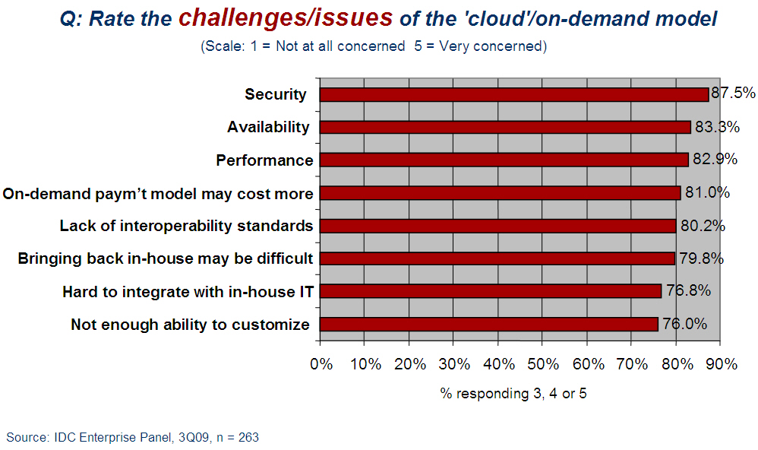
In an IDC survey of IT executives/CIOs published, 87 percent of the respondents cited security as a significant challenge with cloud computing.

Slide 39
Top 2 Worst Data Breaches with the Cloud Computing in 2011
  Sony: failure to protect over 100 million user records.
  Epsilon: it is cloud-based email service, and least 60 million customer emails addresses were breached.

Slide 40
Conclusion
  Cloud computing is latest trend in IT world. Cloud computing provides some strong benefits, but it is not without its risks. The fact is, cloud hosting is still in its relative infancy and many of the biggest risks of using the cloud have still yet to be fully uncovered and tackled.

Slide 41
Computer Worms & Viruses
By Quy Huynh

Slide 42
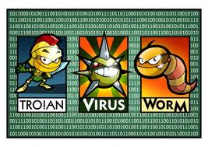
Definition
A computer worm or virus is a computer program that replicate itself in order to spread to other computers.
A Trojan horse is a malware that appears to be helpful. Unlike viruses, Trojan does not replicate themselves.

Slide 43
Mechanism of infection
Viruses
Computer virus attaches itself to a program or file, usually in executable format.
stay in your computer (harmless) until you run or open the malicious program.
Need your action in order to spread such as sharing infecting files or sending emails with viruses as attachment.

Slide 44
Mechanism of Infection
Worms
Unlike viruses, a worm can travel without any of your action.
Sending a copy of itself to everyone in your email address book.

Slide 45
Damages
(Virus) A range of severity:
  Mildly annoying effects such as display pictures, alter system time & keyboard keys to be remapped, etc.
  Damages to hardware, software or files such as delete files, system run slower, & directories displayed as garbage, etc.
(Worm) Due to copying nature & its capability to travel across network, most of the time it will consume system memory or network bandwidth.

Slide 46
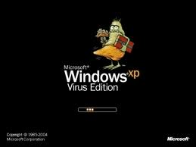
Vulnerability of OS
In 1990s, Microsoft gained market dominance in desktop OS & office suites -> target.
Although Windows is the most popular target OS for viruses, other platforms do exist viruses as well.
Any OS that permits 3rd-party program to run can be infected.

Slide 47
Prevention
Keep your OS up-to-date (especially Windows). ☺
Use Firewall
Almost all email providers such as Yahoo! Or Gmail scan your attachments before uploading on their network & before you downloading them to your computer.

Slide 48
References
http://en.wikipedia.org/wiki/Spyware
http://www.microsoft.com/security/pc-security/spyware-whatis.aspx
http://www.infoworld.com/d/security-central/us-lawmakers-introduce-i-spy-bill-040
http://en.wikipedia.org/wiki/Internet_Spyware_Prevention_Act

Slide 49
References (cont.)
http://en.wikipedia.org/wiki/Full_disclosure
http://locksmithing.wordpress.com/tag/full-disclosure/
http://en.wikipedia.org/wiki/MBTA_vs._Anderson
http://www.cert.org/kb/vul_disclosure.html
http://4taut.co.cc/page/5/

Slide 50
References (cont.)
http://google.about.com/od/socialtoolsfromgoogle/a/googlebombatcl.htm
http://en.wikipedia.org/wiki/Google_bomb
http://www.free-seo-news.com/newsletter249.htm
http://en.wikipedia.org/wiki/Computer_worm
http://en.wikipedia.org/wiki/Computer_virus
http://www.webopedia.com/DidYouKnow/Internet/2004/virus.asp
http://wiki.answers.com/Q/What_kind_of_damages_do_computer_viruses_do_to_your_computer

Slide 51
References (cont.)
  http://en.wikipedia.org/wiki/Cloud_computing
  http://web2.sys-con.com/node/640237
  http://www.infoworld.com/d/security-central/gartner-seven-cloud-computing-security-risks-853?page=0,0
  http://www.informationweek.com/security/attacks/6-worst-data-breaches-of-2011/232301079

Slide 52

Question?

